Slide 1

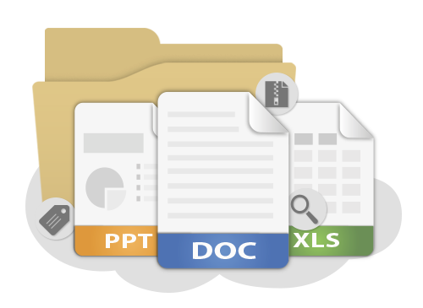

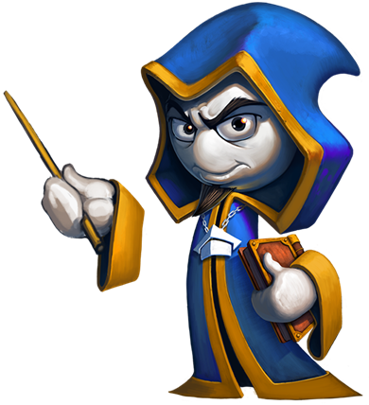
Software Requirements Specification
Reading and Reviewing SRS
QA
Fundamentals
Ivan Yonkov
Training Lead
Software University
http://softuni.bg

Slide 2

Table of Contents
What is SRS?
Requirements
Use Cases
Readability
Review

Slide 3
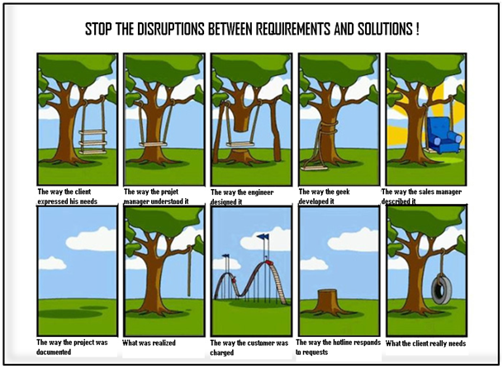
First Look at SRS

Slide 4
First Look at SRS
A software requirements specification (SRS) is a description of a software system to be developed, laying out functional and non-functional requirements, and may include a set of use cases that describe interactions the users will have with the software.
Establishes the basic agreement between costumer and contractor
  What software product to do
  What is NOT expected to do

Slide 5

First Look at SRS (2)
Should enlist enough and necessary requirements for the project development
Should have clear understanding of the product
Often changed after each meeting with customer

Slide 6
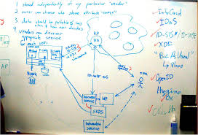
Use Cases

Slide 7
Use Cases
List of interaction steps
Defines relation between an actor and a system
Usually satisfying a goal
Actors are able to take decisions
Decisions lead to subcases

Slide 8

Use Cases (2)
Models
  Can be modeled via UML
  Can be flat text documents
Template
  Name
  Actors
  Preconditions
  Flow
  Post conditions

Slide 9
Use Cases – Live Demo

Slide 10

Readability

Slide 11
Readability
In order to be easy to read, an SRS should answer
  Contains a high-level description of the scope?
  Is it easy to navigate?
  Is it easy to distinct primary from secondary cases?
  Contains links to related features?
  Calls out questions which still need to be addressed?

Slide 12
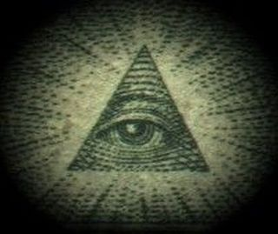
Review

Slide 13
Review
SRS review is going to through the document and trying to understand what the target application is going to be like.
The review results in
  Test scenarios list
  Found errors by statically going through the document
  Questions for better understanding
  Preliminary idea of the test environment
  Test scope identification
  How many test cases will end-up having

Slide 14
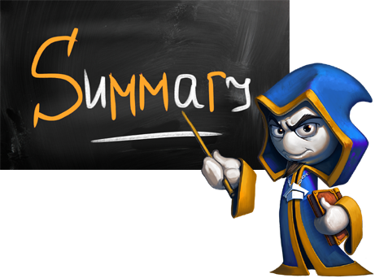
Summary
What is an SRS?
What does it contain?
How use cases are described?
High level and low level cases
Requirements for readable SRS
Reviewing SRS
  How to do it?
  Pre-steps
  Results

Slide 15








Software Requirements Specification
http://softuni.org/courses

Slide 16
License
This course (slides, examples, demos, videos, homework, etc.)
is licensed under the "Creative Commons Attribution-NonCommercial-ShareAlike 4.0 International" license
Attribution: this work may contain portions from
  "Fundamentals of Computer Programming with C#" book by Svetlin Nakov & Co. under CC-BY-SA license
  "C# Part I" course by Telerik Academy under CC-BY-NC-SA license

Slide 17

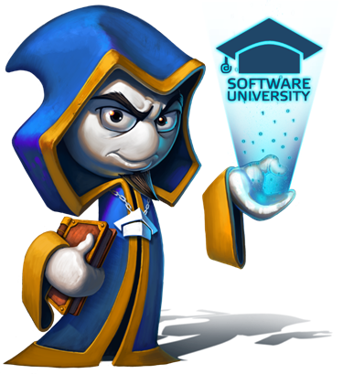



Free Trainings @ Software University
Software University Foundation – softuni.org
Software University – High-Quality Education, Profession and Job for Software Developers
  softuni.bg
  Software University @ Facebook
  facebook.com/SoftwareUniversity
  Software University @ YouTube
  youtube.com/SoftwareUniversity
  Software University Forums – forum.softuni.bg

